Slide 1
Handouts
Lecture №4 Being, Non- Being. Forms of Being.

Slide 2
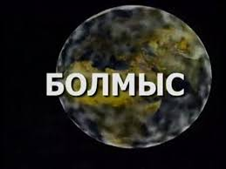
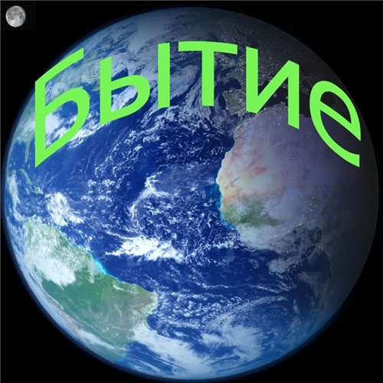
Being is a philosophical concept, conceptualizing the existence of phenomena and objects, synonymous with “existence” and “things”.

Slide 3

Being often acts as an element of the conceptual opposition (e.g., being and consciousness, being and thinking, being and essence).
The problem of being is studied by such philosophical discipline as ontology.

Slide 4
What it means to be human
We’ve all had to puzzle over such profound matters as birth, death, regret, free will, agency, and love. How might philosophy help us think through these vital concerns?
How to approach the question of being is determined by the style of thought, philosophical approach, or methodology. For example, the phenomenological approaches of Husserl and Heidegger locate the question of being on the horizon of human consciousness and existence. Eastern philosophies emphasize the role of "non-being" for our understanding of being.

Slide 5
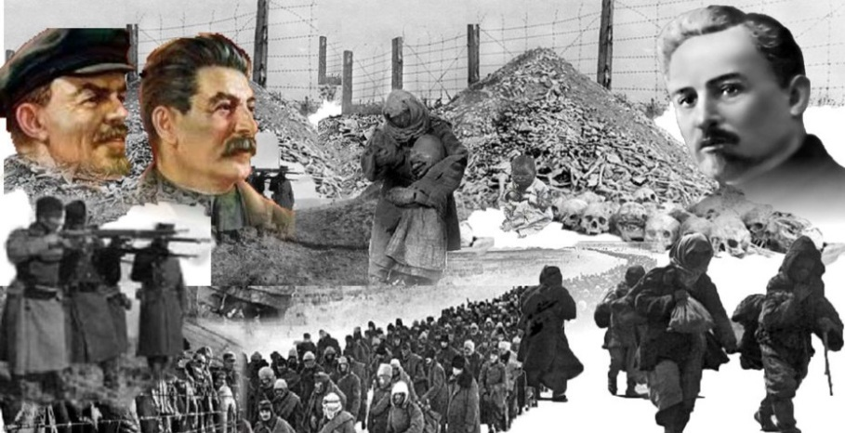
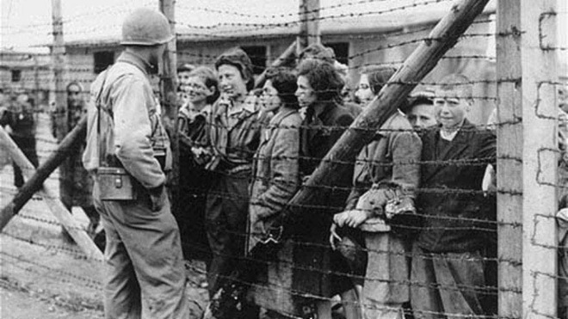
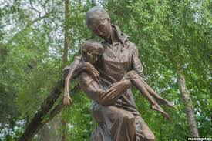
Being of Kazakh:
Life and prosperity in the steppe required patience and perseverance, good health and skills;
The nomadic way of life;
3. The value of freedom and peace;
4. The ability to forgive and forget all the bad things in history. (Asharshylyk 3 million 1921-1933
– 1941 Holocaust 6 million).
5. Positive philosophy for the future
– 1941 Holocaust 6 million).

Slide 6
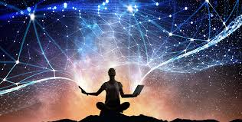
Definition:
Being one of the fundamental concept philosophy which describe widely meaning of life.
For instance: Being of Kazakh people – which includes of all virtues and values of nation.

Slide 7
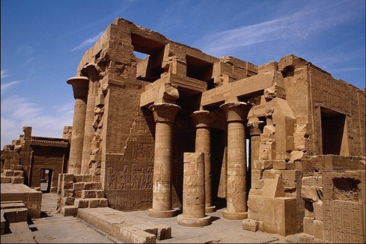
Being in ancient philosophy
As an independent concept, being appears in ancient Greek philosophy, in the Eleatic doctrine.

Slide 8
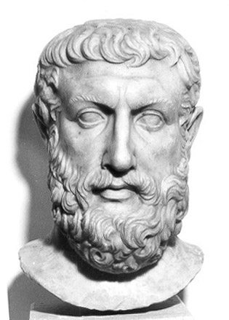
1. Parmenides formulated thesis, which became one of the paradigms of Western ontological standing Thinking: Being is eternal and immutable unity.

Slide 9

Opposing to being (moving manifold) is non-being. Being is the fullness of all qualities that merge in the highest certainty

Slide 10
In its historical beginning, the category of being perceived as controversial and paradoxical construct.

Slide 11
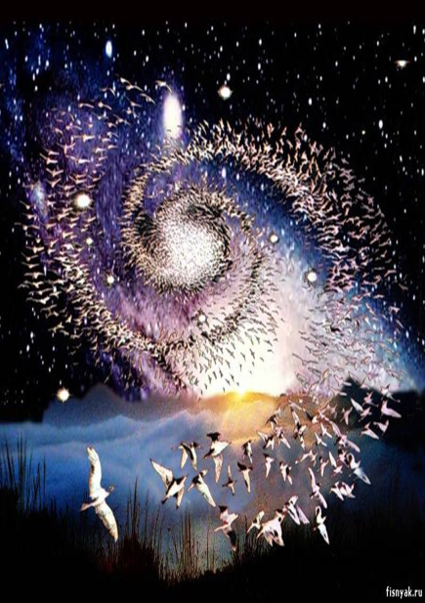
On the one hand, being was a result of the first Greek philosophers, attempted to find an universal principle of organization of the world. “Logos” of Heraclitus, the “number” of Pythagoreans)

Slide 12
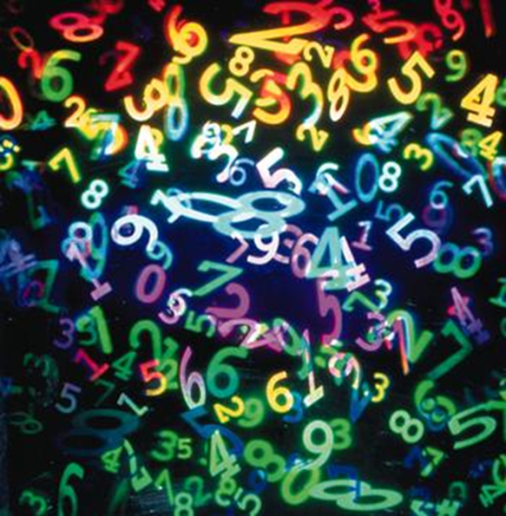

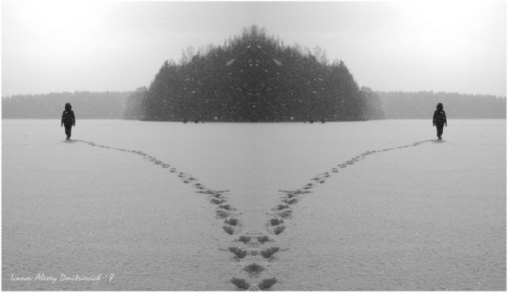
On the other hand, the category of being criticized by sophists (Gorgias) as an empty concept.

Slide 13
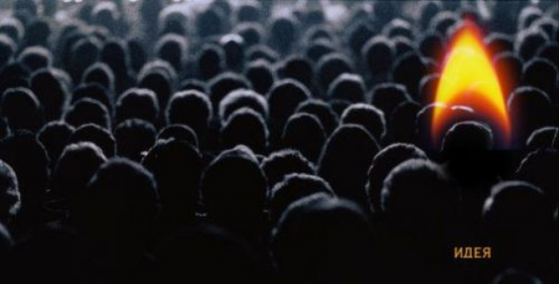
Plato proposed a solution of the antinomies of being in his teaching about “ideas”. Being of Plato is a set of intelligible forms or essences – “ideas” – which is a reflection of the variety of real world.

Slide 14
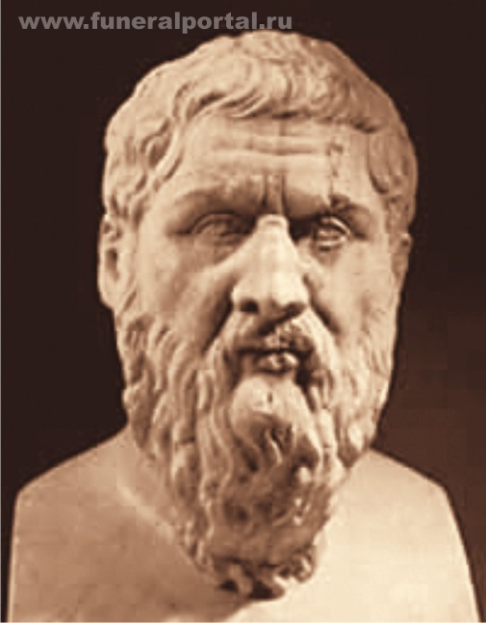
Plato holds difference not only between being and becoming, but between being and “beginning less beginning” of being which Plato calls as “blessing”

Slide 15

An important feature of Plato’s understanding of being was his connection with the category of truth. Truth is a result of ascension to the mere, i.e. to the types of being.

Slide 16

In Aristotle’s philosophy:
denial of being as the highest generic concept

Slide 17
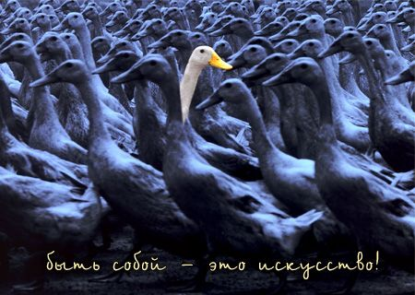
identifying being with the substantial essence of individual thing
attempt to divide different meanings of the word “to be”

Slide 18
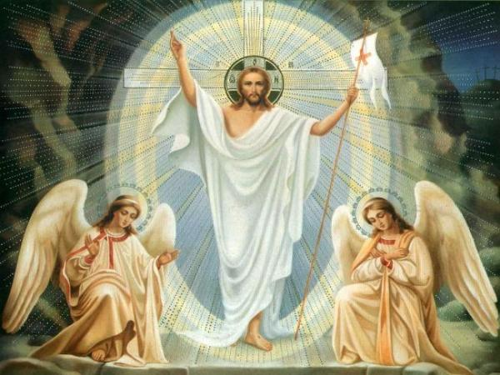
Medieval philosophy was based on the well-known biblical self-determination of God: “I am mere (Jehovah)”

Slide 19
Various interpretations of being expressed in a dispute of realists and nominalists, respectively gravitating to Platonism and Peripatetism.

Slide 20
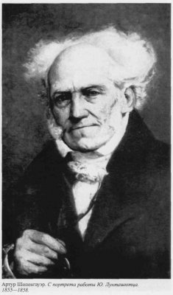
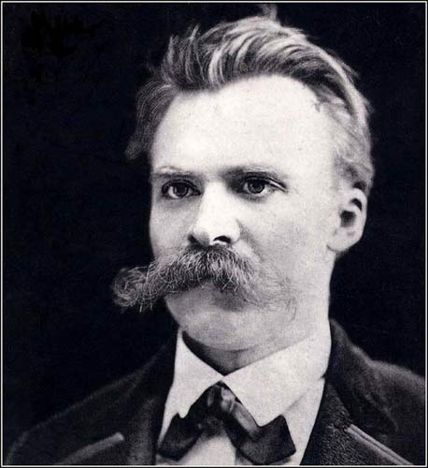
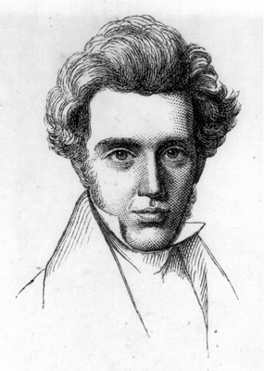
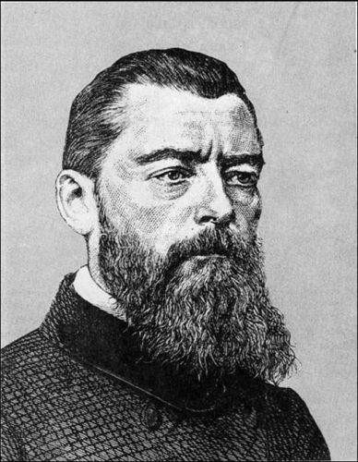
19 th century marked by anti-scholastic ontologism. Idea of being criticized by Kierkegaard, Schopenhauer, Feuerbach, Nietzsche.

Slide 21
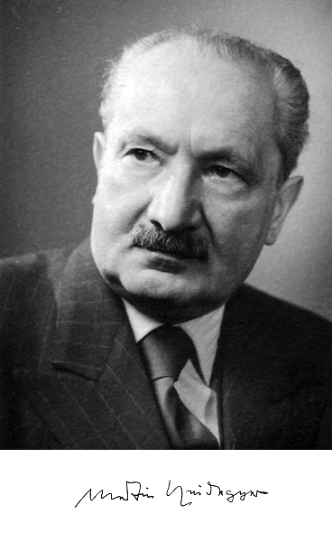
Heidegger’s philosophy can be regarded as a logical final chapter of critique of ontology (in the language of Heidegger – “Metaphysics”).

Slide 22
Being, according to Heidegger, is non-theoretical event (Ereignis) in the world of “things”, “Clearance”(Lichtung) in the universe:
Dasein as “Being-in-the-world”, they are often used hand-in-hand. Being-in-the-world is an existential concept that emphasizes human existence as a state of living with a highly meaningful orientation.

Slide 23
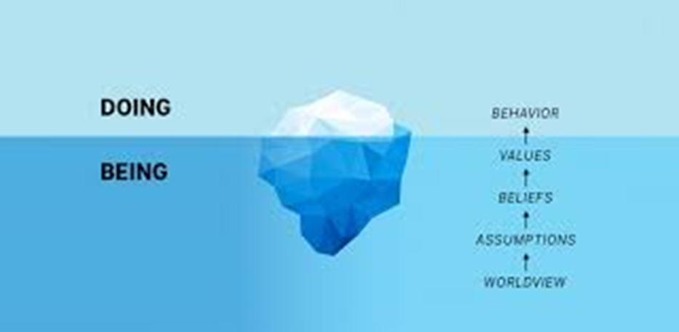
In conclusion:
BEING:
Term used mostly for describing widely;
Substance, essence of life;
synonym of meaning ;
human values;

